Slide 1

Logic Modeling
Chapter Four

Slide 2
Logic Modeling
Decision table
Decision tree
Structured English
Data dictionary

Slide 3
DECISION TABLE
Decision table is a diagram of process where logic is reasonably complicated.
All the possible choices and the conditions, the choices are depending on are represent in tabular form.

Slide 4
DICISION TABLE
Condition Stubs
Contains the various condition that apply to the situation the table is modeling.
Action Stubs
Contains all the possible courses of action that result from combining values of the conditions stubs
Rules
Specifies which action are to be followed for a given set of conditions

Slide 5
Procedure for creating decision tables
Name the conditions and values each condition can assume
Name all possible actions that can occur
List all possible rules
Define the actions for each rule
Simplify the table

Slide 6
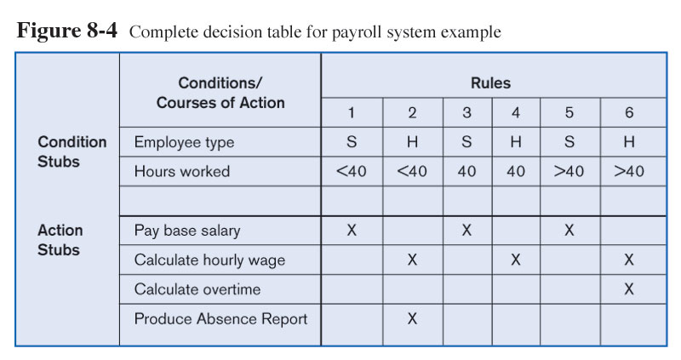

Slide 7
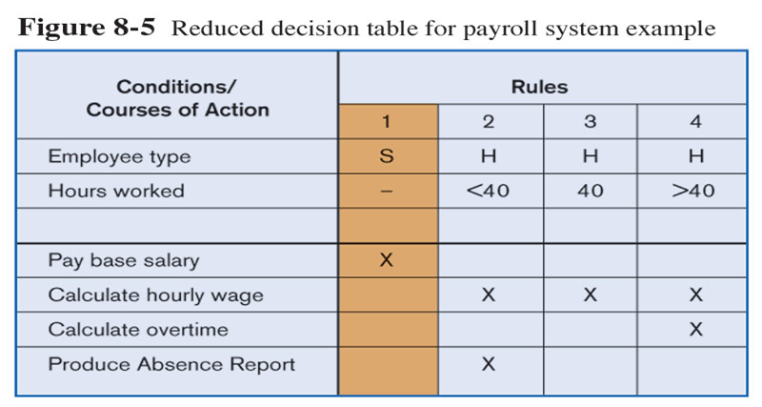

Slide 8
Decision tree
A decision tree is a graphical representation of a decision situation.
Decision situation points (nodes) are connected by arcs and terminate in ovals.
Decision points represented by nodes
Actions represented by ovals

Slide 9
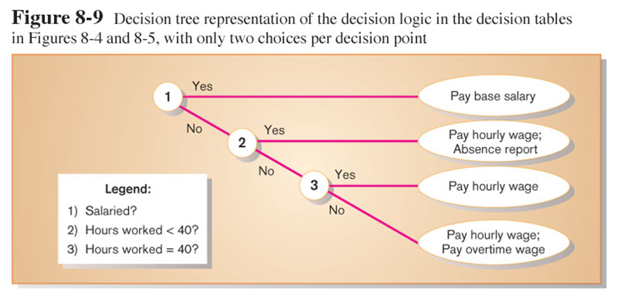
Decision tree representation of salary decision

Slide 10
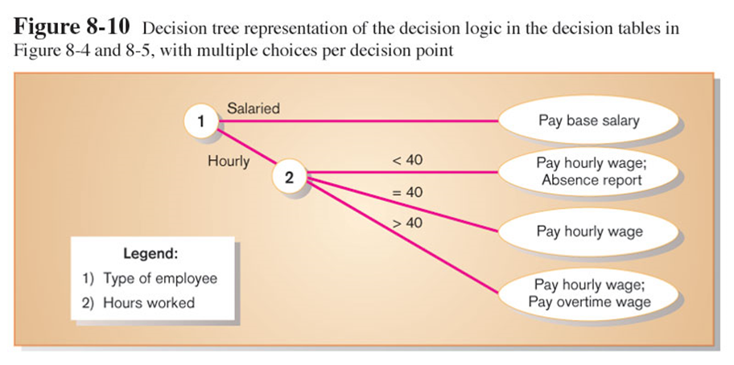
Alternative decision tree representation of salary decision

Slide 11
Structured English
Structured English is a modified form of English used to specify the logic of information processes
Uses a subset of English vocabulary to express process procedures
Action verbs – read, write, print, move, merge, add, sort
Noun phrases – name, address
No adjectives or adverbs

Slide 12
It is possible to represent all three processes used in structured programming: sequence, conditional, repetition
Sequence – no special structure but one statement following another
Conditional – IF THEN ELSE statement; CASE statement
Repetition – DO-UNTIL loops or DO-WHILE loops

Slide 13
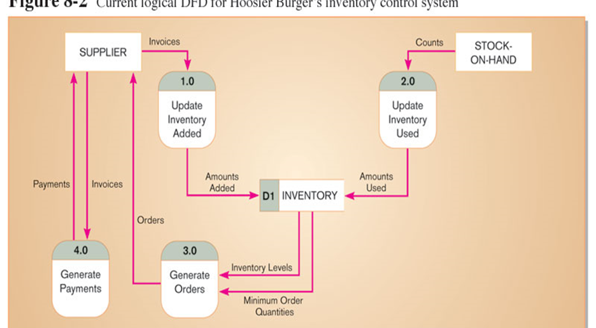

Slide 14
